Slide 1
Batch normalization & dropout

Slide 2
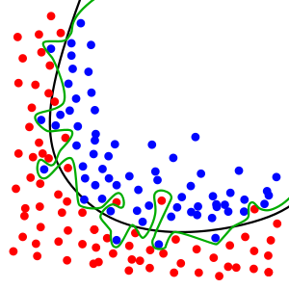
Problem With Overfitting
Large neural nets trained on relatively small datasets can overfit the training data.
This has the effect of the model learning the statistical noise in the training data, which results in poor performance when the model is evaluated on new data, e.g. a test dataset. Generalization error increases due to overfitting.

Slide 3
Methods to reduce Overfitting
Ensemble:
One approach to reduce overfitting is to fit all possible different neural networks on the same dataset and to average the predictions from each model. This is not feasible in practice, and can be approximated using a small collection of different models, called an ensemble.
Dropout:
It is a regularization method that approximates training a large number of neural networks with different architectures in parallel.
The term “dropout” refers to dropping out units (hidden and visible) in a neural network.

Slide 4
Dropout
Deep learning neural networks are likely to quickly overfit a training dataset with few examples.
A single model can be used to simulate having a large number of different network architectures by randomly dropping out nodes during training. This is called dropout.
Computationally cheap and remarkably effective regularization method to reduce overfitting and improve generalization error in deep neural networks

Slide 5
Randomly Drop Nodes
During training, some number of layer outputs are randomly ignored or “dropped out.”
By dropping a unit out, we mean temporarily removing it from the network, along with all its incoming and outgoing connections
This has the effect of making the layer look-like and be treated-like a layer with a different number of nodes and connectivity to the prior layer. In effect, each update to a layer during training is performed with a different “view” of the configured layer.

Slide 6
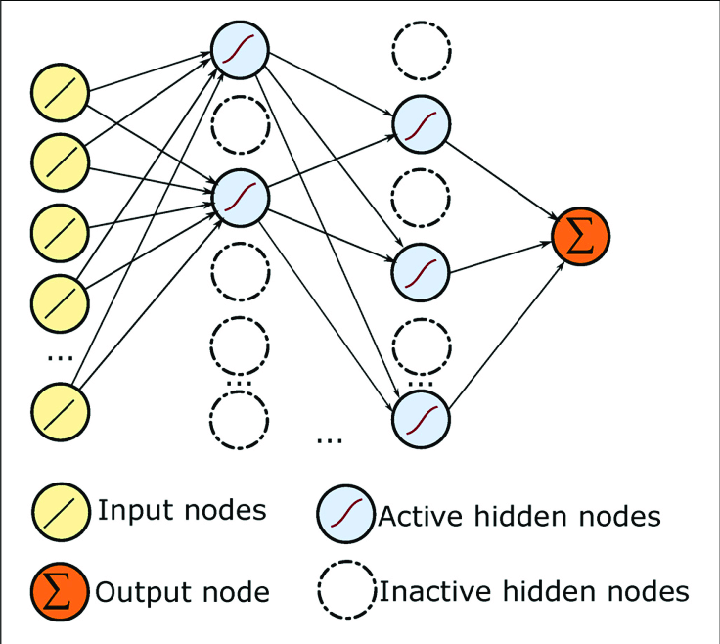
Randomly Drop Nodes

Slide 7
How to Dropout
Dropout is implemented per-layer in a neural network.
It can be used with most types of layers, such as dense fully connected layers, convolutional layers, and recurrent layers such as the long short-term memory network layer.
Dropout may be implemented on any or all hidden layers in the network as well as the visible or input layer. It is not used on the output layer.
Dropout is not used after training when making a prediction with the fit network.

Slide 8
Dropout Rate
The default interpretation of the dropout hyperparameter is the probability of training a given node in a layer,
where 1.0 means no dropout,
and 0.0 means no outputs from the layer.
A good value for dropout in a hidden layer is between 0.5 and 0.8.
Input layers use a larger dropout rate, such as of 0.8.
If n is the number of hidden units in any layer and p is the probability of retaining a unit […] a good dropout net should have at least n/p units
For example, a network with 100 nodes and a proposed dropout rate of 0.5 will require 200 nodes (100 / 0.5) when using dropout.

Slide 9
Example
# example of dropout between fully connected layers
from keras.layers import Dense
from keras.layers import Dropout
...
model.add(Dense(32))
model.add(Dropout(0.5))
model.add(Dense(1))
...
# example of dropout for a CNN
from keras.layers import Dense
from keras.layers import Conv2D
from keras.layers import MaxPooling2D
from keras.layers import Dropout
...
model.add(Conv2D(32, (3,3)))
model.add(Conv2D(32, (3,3)))
model.add(MaxPooling2D())
model.add(Dropout(0.5))
model.add(Dense(1))
...

Slide 10
Batch Normalization & internal covariate shift
Training deep neural networks with tens of layers is challenging as they can be sensitive to the initial random weights and configuration of the learning algorithm.
One possible reason for this difficulty is the distribution of the inputs to layers deep in the network may change after each mini-batch when the weights are updated.
This can cause the learning algorithm to forever chase a moving target. This change in the distribution of inputs to layers in the network is referred to the technical name “internal covariate shift.”

Slide 11
Batch Normalization
Batch normalization is a technique for training very deep neural networks that standardizes the inputs to a layer for each mini-batch. This has the effect of stabilizing the learning process and dramatically reducing the number of training epochs required to train deep networks.

Slide 12
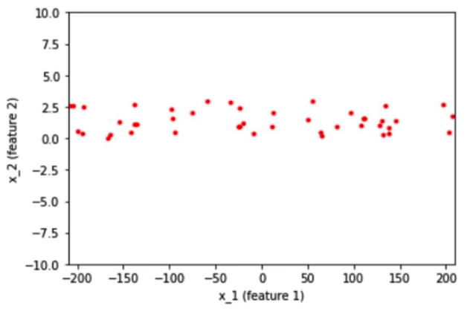
Why Normalize Inputs?
Consider a scenario where we have 2D data with features x_1 and x_2 going into a neural network. One of these features x_1 has a wider spread from -200 to 200 and another feature x_2 has a narrower spread from -10 to 10.

Slide 13
Why Normalize Inputs?
To accommodate this range difference between the features some weights would have to be large and then some have to be small. If we have larger weights then the updates associated with the back-propagation would also be large and vice versa. Because of this uneven distribution of weights for the inputs, the learning algorithm keeps oscillating in the plateau region before it finds the global minima.

Slide 14
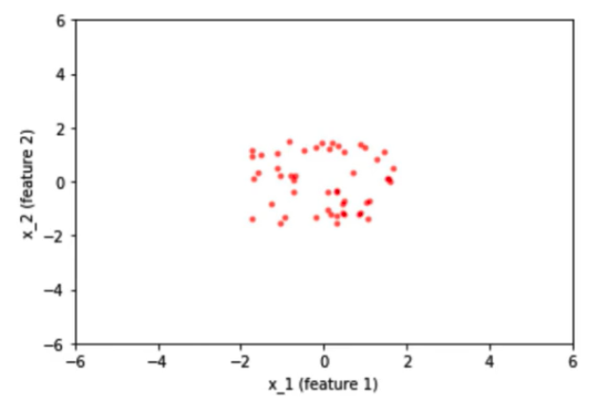
Why Normalize Inputs?
Once we normalized the data, the spread of the data for both the features is concentrated in one region ie… from -2 to 2. Spread would look like this

Slide 15
Why Normalize Inputs?
To avoid the learning algorithm spend much time oscillating in the plateau, we normalize the input features such that all the features would be on the same scale.
Since our inputs are on the same scale, the weights associated with them would also be on the same scale. Thus helping the network to train faster.

Slide 16
Batch Normalization
We have normalized the inputs but what about hidden representatives?
In the neural network, we calculate weighted sum of inputs plus bias. The activation values will act as an input to the next hidden layers present in the network.
No matter input whether we normalized them or not, the activation values would vary a lot as we do deeper and deeper into the network based on the weight associated with the corresponding neuron.
In order to bring all the activation values to the same scale, we normalize the activation values such that the hidden representation doesn’t vary drastically and also helps us to get improvement in the training speed.

Slide 17
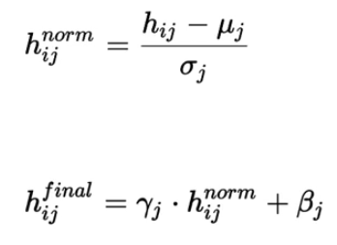
Why is it called batch normalization?
Since we are computing the mean and standard deviation from a single batch as opposed to computing it from the entire data.
Batch normalization is done individually at each hidden neuron in the network.
batch normalization introduces two extra parameters — Gamma and Beta.

Slide 18
Batch Normalization
This process is also called “whitening” when applied to images in computer vision.
Batch normalization can be implemented during training by calculating the mean and standard deviation of each input variable to a layer per mini-batch and using these statistics to perform the standardization.
Alternately, a running average of mean and standard deviation can be maintained across mini-batches, but may result in unstable training.

Slide 19
Example
# example of batch normalization for an mlp
from keras.layers import Dense
from keras.layers import BatchNormalization
...
model.add(Dense(32, activation='relu'))
model.add(BatchNormalization())
model.add(Dense(1))
...
# example of batch normalization for an cnn
from keras.layers import Dense
from keras.layers import Conv2D
from keras.layers import MaxPooling2D
from keras.layers import BatchNormalization
...
model.add(Conv2D(32, (3,3), activation='relu'))
model.add(Conv2D(32, (3,3), activation='relu'))
model.add(BatchNormalization())
model.add(MaxPooling2D())
model.add(Dense(1))
...

Slide 20
Parameters in NN
Model Parameters: In NN X,Y are input, output and The variable w is a weight vector which is learned during the training phase. This is what’s known as a model parameter
“Training a model” involves using an optimization procedure to determine the best model parameter
Hyperparameters: sometimes also knowns as “nuisance parameters. These are values that must be specified outside of the training procedure.

Slide 21
Hyperparameter Tuning
A hyperparameter is a parameter whose value is set before the learning process begins.
Some examples of model hyperparameters include:
The penalty in Logistic Regression Classifier i.e. L1 or L2 regularization
The learning rate for training a neural network.
The C and sigma hyperparameters for support vector machines.
The k in k-nearest neighbors.
In sklearn, hyperparameters are passed in as arguments to the constructor of the model classes.

Slide 22
Hyperparameter Tuning
Vanilla linear regression doesn’t have any hyperparameters. But variants of linear regression do.
Ridge regression and lasso both add a regularization term to linear regression; the weight for the regularization term is called the regularization parameter.
Decision trees have hyperparameters such as the desired depth and number of leaves in the tree.
Support vector machines (SVMs) require setting a misclassification penalty term. Kernelized SVMs require setting kernel parameters like the width for radial basis function (RBF) kernels.

Slide 23
What Do Hyperparameters Do?
A regularization hyperparameter controls the capacity of the model, i.e., how flexible the model is, how many degrees of freedom it has in fitting the data.
Proper control of model capacity can prevent overfitting, which happens when the model is too flexible, and the training process adapts too much to the training data, thereby losing predictive accuracy on new test data.
So a proper setting of the hyperparameters is important.

Slide 24
Tuning Strategies
We will explore two different methods for optimizing hyperparameters:
Grid Search
Random Search
Smart Hyperparameter Tuning

Slide 25
Grid Search
Grid search is a traditional way to perform hyperparameter optimization. It works by searching exhaustively through a specified subset of hyperparameters.
The benefit of grid search is that it is guaranteed to find the optimal combination of parameters supplied.
The drawback is that it can be very time consuming and computationally expensive.
For example, if we want to set two hyperparameters C and Alpha of Logistic Regression Classifier model, with different set of values. The gridsearch technique will construct many versions of the model with all possible combinations of hyerparameters, and will return the best one.

Slide 26
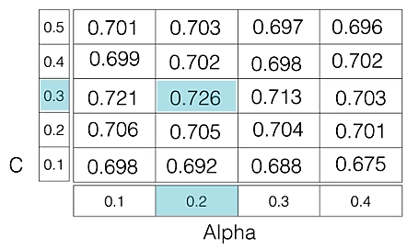
Grid Search
As in the image, for C = [0.1, 0.2, 0.3, 0.4, 0.5] and Alpha = [0.1, 0.2, 0.3, 0.4].
Grid search evaluates every one of them, and returns the winner For a combination C=0.3 and Alpha=0.2, performance score comes out to be 0.726(Highest), therefore it is selected.

Slide 27
# Necessary imports
from sklearn.linear_model import LogisticRegression
from sklearn.model_selection import GridSearchCV
# Creating the hyperparameter grid
c_space = np.logspace(-5, 8, 15)
param_grid = {'C': c_space}
# Instantiating logistic regression classifier
logreg = LogisticRegression()
# Instantiating the GridSearchCV object
logreg_cv = GridSearchCV(logreg, param_grid, cv = 5)
logreg_cv.fit(X, y)
# Print the tuned parameters and score
print("Tuned Logistic Regression Parameters: {}".format(logreg_cv.best_params_))
print("Best score is {}".format(logreg_cv.best_score_))

Slide 28
Random Search
Random search differs from grid search mainly in that it searches the specified subset of hyperparameters randomly instead of exhaustively.
In otherwords, It moves within the grid in random fashion to find the best set hyperparameters. random search only evaluates a random sample of points on the grid.
This approach reduces unnecessary computation thus decreased processing time.
We aren’t guaranteed to find the optimal combination of hyperparameters.

Slide 29
# Necessary imports
from scipy.stats import randint
from sklearn.tree import DecisionTreeClassifier
from sklearn.model_selection import RandomizedSearchCV
# Creating the hyperparameter grid
param_dist = {"max_depth": [3, None],
"max_features": randint(1, 9),
"min_samples_leaf": randint(1, 9),
"criterion": ["gini", "entropy"]}
# Instantiating Decision Tree classifier
tree = DecisionTreeClassifier()
# Instantiating RandomizedSearchCV object
tree_cv = RandomizedSearchCV(tree, param_dist, cv = 5)
tree_cv.fit(X, y)
# Print the tuned parameters and score
print("Tuned Decision Tree Parameters: {}".format(tree_cv.best_params_))
print("Best score is {}".format(tree_cv.best_score_))

Slide 30
Smart Hyperparameter Tuning
Instead of generating all the candidate points up front and evaluating the batch in parallel, smart tuning techniques pick a few hyperparameter settings, evaluate their quality, then decide where to sample next.
This is an inherently iterative and sequential process. It is not very parallelizable.
The goal is to make fewer evaluations overall and save on the overall computation time.
Three method for smart tuning are derivative-free optimization, Bayesian optimization, and random forest smart tuning.
(https://www.oreilly.com/library/view/evaluating-machine-learning/9781492048756/ch04.html)

